Slide 1
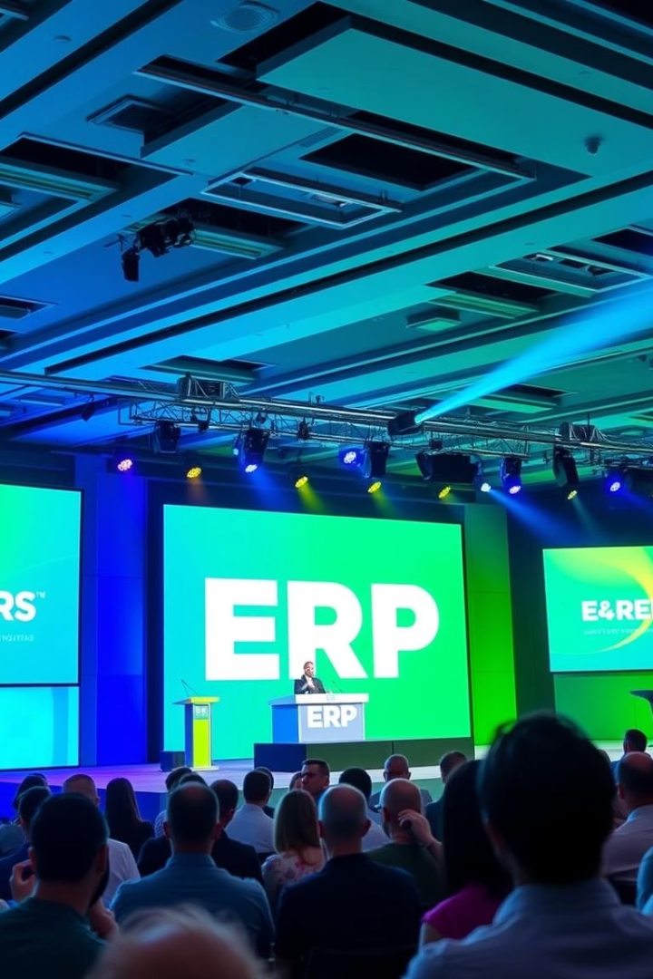
Welcome to Care Conference
Corporate Munim
The Business Explorer

Slide 2
Agenda Of The Day
10:00 – 10:30
Welcome Speech & Company Profile
10:30 – 01:00
Review of Past Enhancements
01:00 – 02:00
Lunch Compliment
02:00 – 03:30
Review of Past Enhancements continue and Discussion on Upcoming Enhancements
03:30 – 04:00
High Tea and Refreshments
04:00 – 05:00
Open Discussion & Q&A

Slide 3

Company Introduction
01

Slide 4

Empowering the enterprise since 1991......
"In the business world, the rear-view mirror is always clearer than the windshield." -Warren Buffett
Empowering the enterprise since 1991......
We are working in more than 15+ countries with the client network of 1500
World's first enterprise solution that's work on SadOP technology.
Over 80% of the company's new business each year is driven by client referrals, supported by strong business design and solid intellectual and financial capital.

Slide 5




Our Journey of Excellence and Innovation
SadOP Technology
15 + Countries
GESIA Award
ERP Brand Award
The Third Generation Hybrid Technology to Offers all Advantages of On Premises, Cloud and SaaS WithOut Any Limitation
Client Base in 15 + Countries Corporate Munim- The Business Explorer Encompassing Enterprise Solution
We honored with the prestigious GESIA Award, recognizing our excellence and innovation in ERP.
We honored with the prestigious “ERP Brand of the Year – 2014”

Slide 6

Review
Of Past Enhancements
02
Summary of Implemented Features & Improvements

Slide 7
Enhancement Points Description
Stored procedure required in Payroll Addition and Deduction
Add amend edit and delete and print conditional based disable using the executable file based on the your condition.
Generate batch button in the GRN form.
GSTR3B,GSTR2A,GSTR2B
WE will do a count ,sum, avg in the grid level.
Barcode integration in the system.
Delete sp pass in the exectuble file. (Header Id and Formmode is mandatory on stored procedure)
QC non confirmation in QC inward and QC production.
Auto Production entry in Production entry.
HDFC API integration in Bank Payment
Show popup message when cancelling e-Invoice for newly generated sales invoices
Added new vehicle type ‘ODC (Over Dimensional Cargo)’ in E-Way Bill form
Added e-Way Bill cancellation option similar to e-Invoice

Slide 8
Enhancement Points Description
In Reference transaction import functionality is added
Created master forms via Reference Transaction
Allow Part A of E-Way Bill without vehicle number; combine Part A & B when vehicle number is later available
Vendor Portal
Validation for duplicate book types in JV form like 'Duplicate book type is not . allowed'
Added “Allow same Ledger for multiple Effect” option in Expense Voucher
Added Point of Sale (POS) Form in Sales Module
Show and carry forward Across UDF in MRP form under Work Order tab
Added “PREPARED BY” field in Common Authorization form
Added Across UDF functionality in the 1st grid of Work Order creation
Added checkbox “Hide Export & Print Button” in User Rights Master
India mart and trade india integration in the Sales inquiry form.
Created new form: “WIP Godown Issue Indent”

Slide 9
Enhancement Points Description
Created new form: “WIP Godown Issue”
Created new form: “WIP Godown Receipt”
Created new form: “WIP Godown Issue Receipt”
Add “Hold” option in Authorization window
Allow sending WhatsApp messages via Schedule Intimation and Transaction Intimation
Add button in Work Order form (Sales Order Details grid) for "Remarks" and "Details Description" columns
Added "Net Amount" field at grid level in Common Authorization Form
Carry forward Sales Order tolerance to Work Order Creation form
Item name duplication check across different Item Groups – with "Yes/No" confirmation on conflict
Implement Domain User Functionality (Windows authentication: auto-set username during login)
Added “NOTIFICATION” radio button in Schedule Intimation to send alerts to selected users
In Transaction > Payment Term: allow merging of documents with same event name but different descriptions
In Work Order: auto-populate data based on Sales Order's Conversion Factor

Slide 10
Enhancement Points Description
Added Detailed Description field in Break Down Indent form
Added “NOTIFICATION” radio button in Transaction Intimation (same as Schedule Intimation)
Added "Process Name" column in Returnable Issue Indent, and carry forward into Returnable Issue form
Added <BranchGodownMasterId> in default criteria for Adjustment tab (Bank/Cash Payment Advice)
In Common Authorization Form, add checkbox: “View in Selected Transaction Format”
In Transaction Intimation: add checkboxes “RETURN” & “HOLD” — trigger mail + mobile notification on click
Allow quantity edit in Sales Inquiry if Quotation is done but Sales Order is not
In Category Master, allow duplicate short names with confirmation popup
Carry forward UDF from Sales Order to Sales Forecast to Production Cycle.
Added “Rate Per Quantity Formula” in Sales Quotation and Sales Order forms
In report parameter basics form >> in option >> in result option required to add new value like 'Result In PDF'
In Sales Quotation/Sales Order → add “Conversion Factor Formula” under options
Add “Conditional Color” option in forms for visual logic formatting

Slide 11
Enhancement Points Description
Enable UDF in Sales Follow-Up at document level with dropdown, on-the-fly and need to insert query in result set
Added two radio buttons in User Rights Master: Crystal/PDF for report display + set default mobile zoom
Added Quantity Formula in Work Order Creation (same as Process Receipt)
Quantity Formula required in Sales Quotation & Sales Order (like Process Receipt)
Pass BranchGodownMasterID in Prospect, Customer, Employee, and Representative search criteria
Fix Cancellation Reason to use predefined dropdown list (remove on-the-fly entry)
Merge multiple report-generated PDF documents into a single file in sequence
Set default file path for digitally signed PDFs in Authorization form
Set form mode state (Add/Edit/Amend) in transaction properties
In Supplier/Customer Master → Others tab → Additional Shipping Address: Add “Set Default” checkbox at grid level
Add Copy & Paste option for “Cost Group Name” in Sales Order form
Require tab sequence and shortcut keys in Item Search window
Enable column sorting in HSN Master

Slide 12
Enhancement Points Description
In Item Search, move cursor to the first filled parameter after search
Set the weigh bridge connection in any field and udf.
Grid filter in Reference transaction and grid wise report.
Ensure YearID is considered in UDF formulas within Reference Transactions
Add Insurance details (policy, % and amount) in Job Work Issue & Receipt “More Details” tab (similar to Sales Invoice structure)
Increase Item Name field size from 100 to 150 characters in Item Master
UDF “ADD” not carried forward from Purchase Quotation to Purchase Quotation Comparison
Make “Quantity” field editable in Purchase Quotation Comparison for carry forward to Purchase Order
In Consumption Master: add radio buttons for “Shift Hours” and “Working Hours”
Prevent transaction currency change when data is carried forward from Inquiry to Quotation
Prompt warning message regarding inventory impact while creating Item Master and Item Group

Slide 13

03
Time to Refuel

Slide 14

Future Enhancements
04
Planned Features to Improve Efficiency & User Experience

Slide 15
Upcoming Enhancement Description
Set default values for UDF (User-Defined Field) dropdowns.
Enable conditional messaging based on specific criteria.
Configure queries to support conditional color formatting.
We will create an E-Way Bill Barcode and QR Code generator in the system.
We will create a horizontal selection in the SADOP item selections.
We will develop a mobile-responsive app for SADOP entry in the mobile application.
We will implement an advanced grid in the Authorization window.
We will provide the last authorized name in the common Authorization form.
We will generate a batch in the Process Receipt form.
We will consider a reference transaction header UDF as a criterion in the search criteria.
We will consider a grid UDF as a criterion in the search criteria.
We will provide a batch grid in Purchase Advice.

Slide 16
Upcoming Enhancement Description
We will show unauthorized Prospect/Customer/Supplier entries in Sales Inquiry, Sales Quotation, and Sales Follow-up.
We will create a QC tab in the Item Group Master.
We will provide a form-wise ledger name for financial postings.
We will display the first grid count entered by the user, and then data will be shown based on that count, with sorting (Oldest to Newest or Newest to Oldest).
We will store the local machine name in the user information.
We will provide an auto-search functionality in the Ledger Master and Item Master.
We are planning to integrate Microsoft Fabric with Corporate Munim to enhance data processing and analytics capabilities.
The integration will include Data Factory, Synapse Data Engineering, Synapse Data Science, Machine Learning, real-time data analysis, and Power BI integration.

Slide 17

05
It's Tea Time : A Journey Through Flavors and Conversations

Slide 18
Open Discussion & Q&A
06
Your inputs help shape the future of Corporate Munim

Slide 19
Share Your Thoughts
Suggestions for improvements
Feedback on current workflows
Questions about Corporate Munim or IT initiatives
How You Can Contribute
Share use cases or pain points
Highlight missing features or enhancements
Raise concerns and ideas for better collaboration

Slide 20
Trusted by Industry Leaders
Serving a wide range of companies with proven ERP solutions

Slide 21


Slide 22
Thank You for
Participating

